Slide 1
Chapter 5
Analysis and Design of beams for Bending

Slide 2
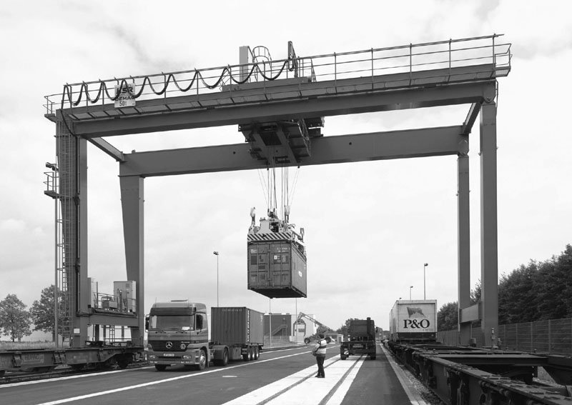
Beams for Bending
This part is devoted to the analysis and design of beams. Beams are structural members supporting loads applied at various points along the member. They are usually straight long and prismatic
The beam supporting the overhead cranes system shown are subjected to transverse loads causing the beams to bend.
We will determine the normal stresses in beams resulting from transverse loads.
Transverse loading causes only bending and shear in the beam. When the loads are not at a right angle to the beam, they also produce axial forces in the beam

Slide 3
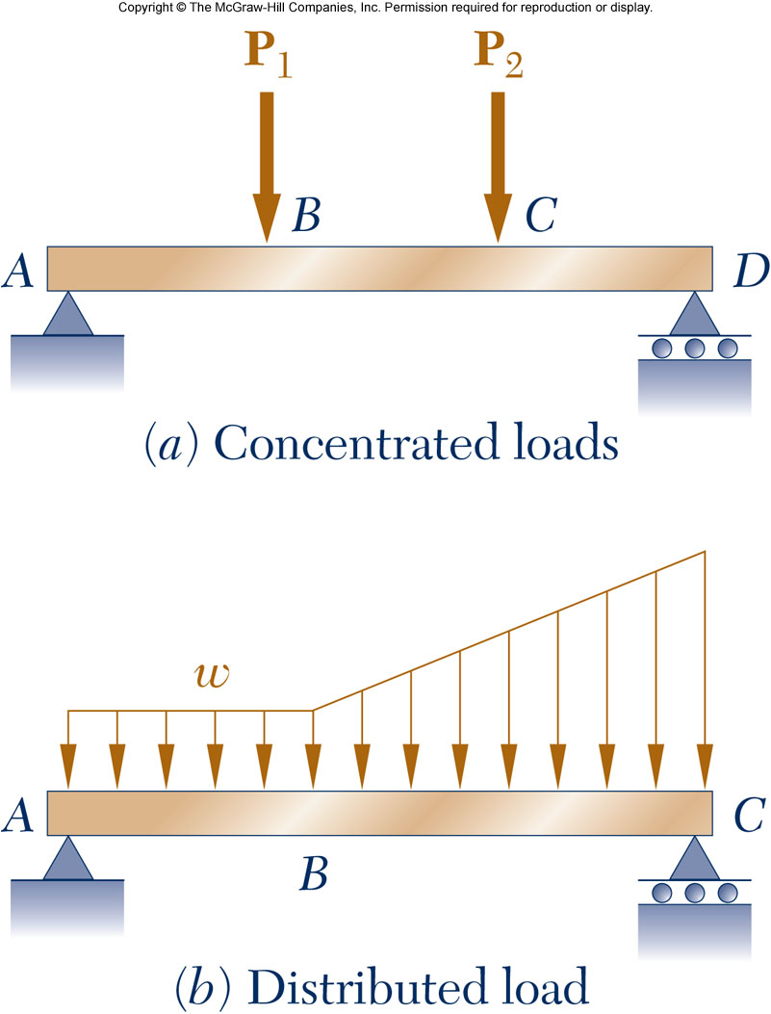
Introduction
Objective: Analysis and design of beams
Beams are structural members supporting loads at various points along the member
Transverse loadings of beams are classified as concentrated loads or distributed loads
Applied loads result in internal forces consisting of a shear force (from the shear stress distribution) and a bending couple (from the normal stress distribution)

Slide 4
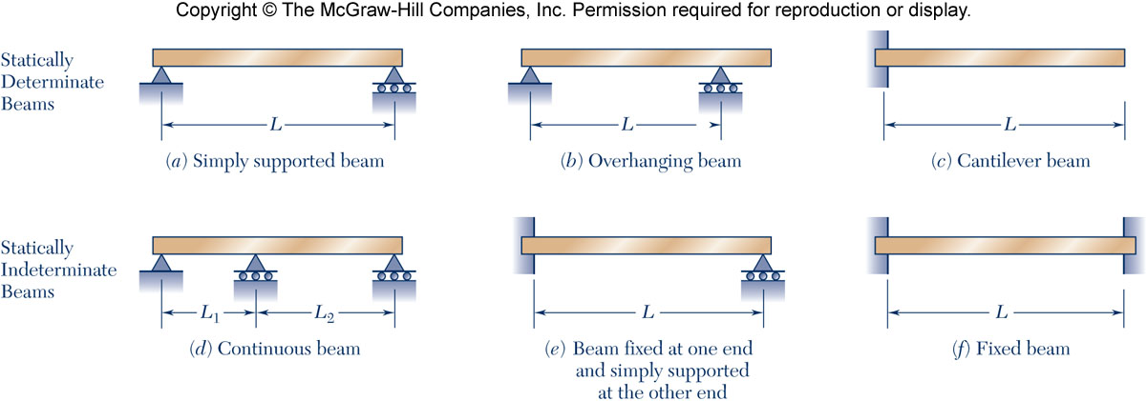
Classification of Beam Supports
Statically determinate beams: the reactions of the support of a beam involve only three unknowns that can be determined by the method of statics
Statically indeterminate beams: the reactions of the support of a beam involve unknowns that cannot be determined by the method of statics alone. Deformations of the beam should be used to solve for the unknowns.

Slide 5
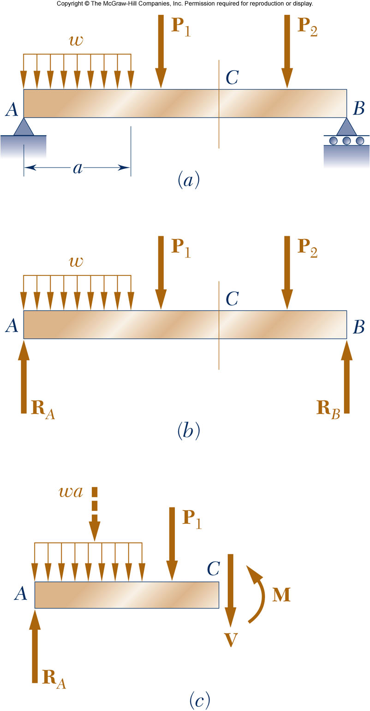
Introduction
If we pass a section through a point C of a beam, the internal forces in the section will consist of a shear force V and a bending moment M.
The bending moment M creates normal stresses in the cross section, while the shear force creates shearing stresses.
In most cases the dominant criterion in the design of a beam for strength is the maximum value of the normal stress in the beam.
In this part we will determine the normal stresses due to the bending moment M. The determination of the shearing stresses resulting from the shear force is left for the next chapter.

Slide 6
Introduction
Normal stress due to bending
σ_{m} is inversely proportional to S thus selecting a beam with a large section modulus is important.
σ_{m} is proportional to the magnitude of M thus it is important to determine the magnitude and location of the maximum bending moment.

Slide 7
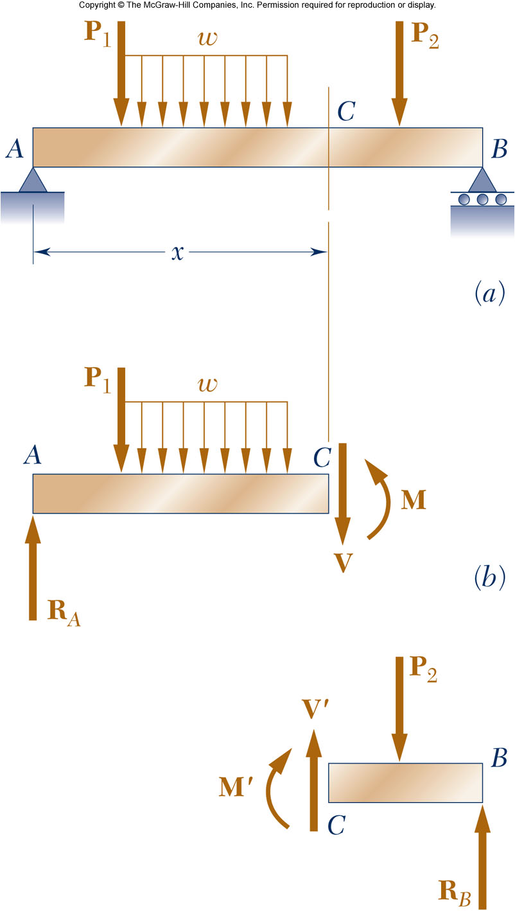
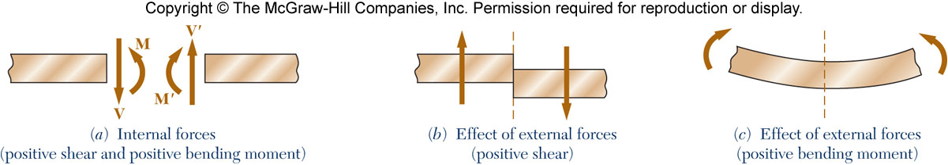
Shear and Bending Moment Diagrams
Determination of the maximum normal and shearing stresses requires identification of maximum internal shear force and bending moment. The shear force and bending moment at a point are determined by passing a section through the beam and applying an equilibrium analysis on the beam portions on either side of the section.
Sign conventions for shear forces V and V’ and bending couples M and M’

Slide 8
Example 1
5-10: Draw the shear and bending moment diagrams for the beam and loading shown, and determine the maximum absolute value (a) of the shear, (b) of the bending moment.

Slide 9
Example 1

Slide 10
Example 1

Slide 11
Example 2
5-23: Draw the shear and bending-moment diagrams for the beam and loading shown, and determine the maximum normal stress due to bending.

Slide 12
Example 2

Slide 13
Example 2

Slide 14
Example 3
5-24: Draw the shear and bending-moment diagrams for the beam and loading shown and determine the maximum normal stress due to bending.

Slide 15
Example 3

Slide 16
Example 3

Slide 17
Example 4
5-29: Knowing that P = Q = 480 N, determine (a) the distance a for which the absolute value of the bending moment in the beam is as small as possible, (b) the corresponding maximum normal stress due to bending.

Slide 18
Example 4

Slide 19
Example 4

Slide 20
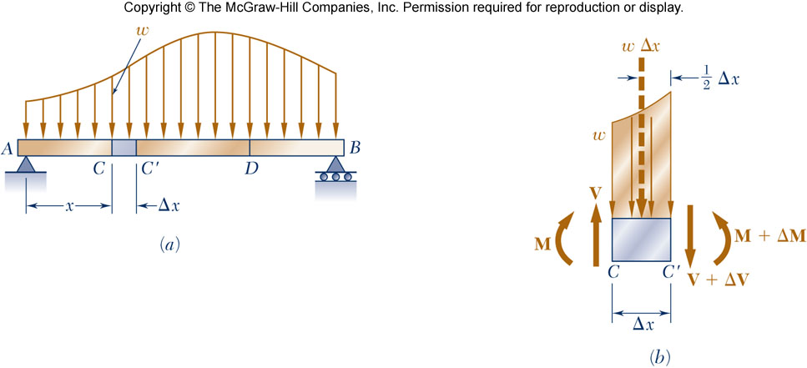
Load, Shear, and Bending Moment
When a beam carries more than two or three concentrated loads, or distributed loads, the method outlined before will become quite cumbersome.
Relationship between load and shear:
V_{D}-V_{C} = - (area under load curve between C and D)

Slide 21
Load, Shear, and Bending Moment
Relationship between load and bending moment:
M_{D}-M_{C} = (area under shear curve between C and D)

Slide 22
Example 5
5-45: Draw the shear and bending-moment diagrams for the beam and loading shown, and determine the maximum absolute value (a) of the shear, (b) of the bending moment.

Slide 23
Example 5

Slide 24
Example 5

Slide 25
Example 6
5-57: Draw the shear and bending-moment diagrams for the beam and loading shown and determine the maximum normal stress due to bending.

Slide 26
Example 6

Slide 27
Example 6

Slide 28
Design of Prismatic Beams for Bending
The design procedure:
Determine the value of σ_{all} for the material selected from a table of properties of the material
Draw the shear and bending diagrams corresponding to the specified loading conditions and determine |M|_{max}
Determine the minimum allowable value S_{min}
Among the beam section choices which have an acceptable section modulus, select the one with the smallest weight per unit length smallest cross sectional area (least expensive)

Slide 29
Example 7
5-67: For the beam and loading shown, design the cross section of the beam, knowing that the grade of timber used has an allowable normal stress of 12 MPa.

Slide 30
Example 7

Slide 31
Example 8
5-77: Knowing that the allowable normal stress for the steel used is 160 MPa, select the most economical S-shape beam to support the loading shown.

Slide 32
Example 8

Slide 33
Example 8

Slide 34
Example 9
5-90: Beams AB, BC, and CD have the cross section shown and are pin-connected at B and C. Knowing that the allowable normal stress is +110 MPa in tension and -150 MPa in compression, determine (a) the largest permissible value of P if beam BC is not to be overstressed, (b) the corresponding maximum distance a for which the cantilever beams AB and CD are not overstressed.

Slide 35
Example 9

Slide 36
Example 9

